Slide 1

Programming Two (csc7051)
Aidan McGowan
Test Driven Development

Slide 2
Test-driven development
Test-driven development (TDD) is an advanced technique of using automated unit tests to drive the design of software and force decoupling of dependencies.
The result of using this practice is a comprehensive suite of unit tests that can be run at any time to provide feedback that the software is still working.
This technique is heavily emphasized by those using Agile development methodologies.

Slide 3
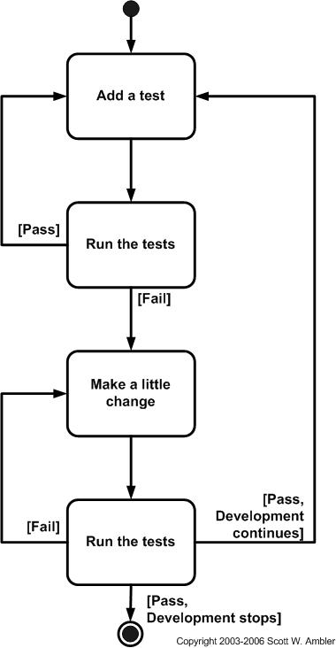
TDD - the process
Test-driven design (TDD) is a development technique where you must first write a test that fails before you write new functional code. TDD is being quickly adopted by agile software developers for development of application source code

Slide 4
Pros of Test-Driven Development
Forces critical analysis and design
  the developer cannot create the production code without truly understanding what the desired result should be and how to test it.
Software tends to be better designed
  loosely coupled and easily maintainable, because the developer is free to make design decisions and refactor at any time with confidence that the software is still working. This confidence is gained by running the tests. The need for a design pattern may emerge and the code can be changed at that time.
Better quality code and reduced costs
  Developers find bugs earlier in the development process. TDD studies have shown a drop in the defect density of between 40% and 90% for teams using test driven development (Nagappan et al)
Notes:
Nachiappan Nagappan et al. (2008). Realizing quality improvement through test driven development: results and experiences of four industrial teams. Available: http://research.mic

Slide 5

Defect Density
The number of confirmed defects detected in software/component during a defined period of development/operation divided by the size of the software / component.
The ‘defects’ are:
  confirmed and agreed upon (not just reported).
  Dropped defects are not counted.
The period might be for one of the following:
  for a duration (first month, the quarter, or the year).
  for each phase of the software life cycle.
  for the whole of the software life cycle.
Size – could be the number of lines of code

Slide 6

Cons of Test-Driven Development
Integration with legacy code, it is easier to introduce unit testing at the start of a coding effort than it is to add unit tests during the maintenance phase of a project.
Resistance of adoption by traditional “code and fix” programmers.
Prototypes – may slow development

Slide 7
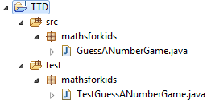
Project setup
Create the project structures
(src, test and appropriate packages).
Include a skeleton class in src folder)
Add a JUnit test class to test the class in the src folder.

Slide 8
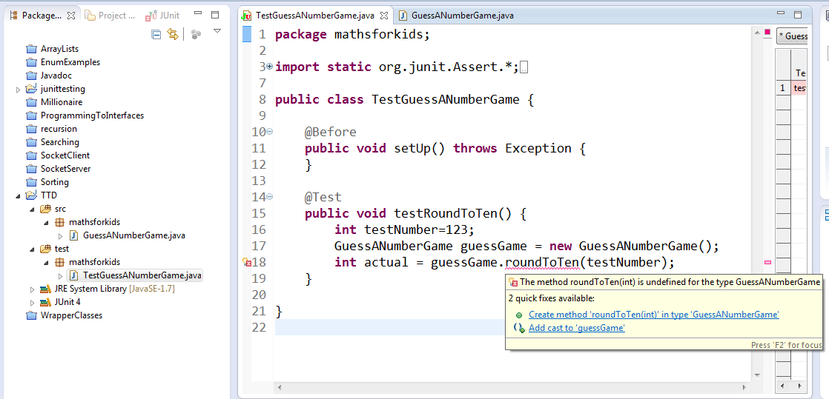
Write some test code… and fix

Slide 9
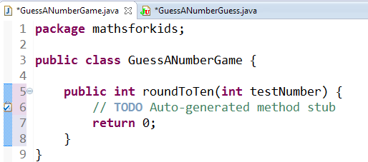
Results in new (generated) code

Slide 10
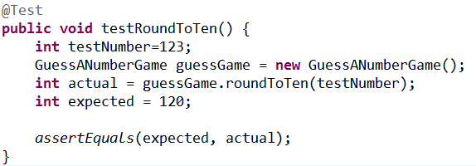
Write some more of the test case

Slide 11
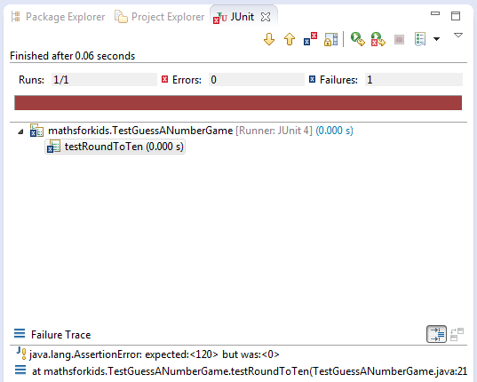
Run the test case - fail

Slide 12
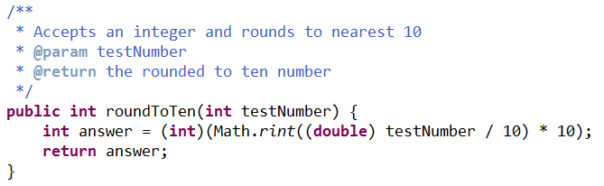
Make a little change to source code

Slide 13
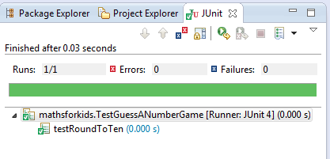
Run the test again

Slide 14
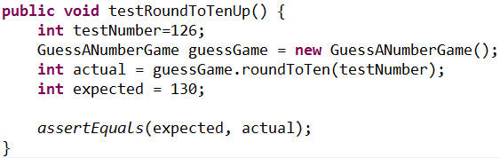
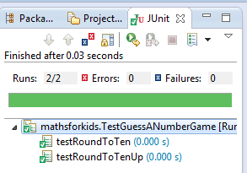
Is the test exhaustive. Does it cover all possible outcomes ?
What about rounding up ? Add a new test case.
Rerun all test cases including the new one…

Slide 15
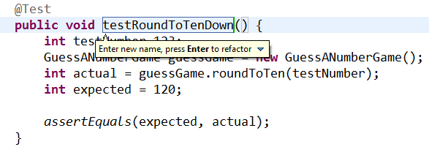
Refactor the test cases
It would also be sensible to refactor (rename) the original test case to maintain naming consistency.

Slide 16
TDD Exercise
Add the following functionality to the application. Using TDD techniques.
Remember write the test case first. Then when it fails add some code… keep going until it passes.

